Slide 1
计算机辅助药物设计 机器学习 – 回归

Slide 2
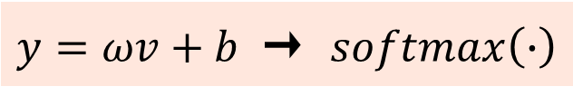


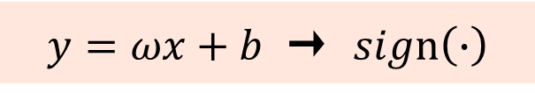

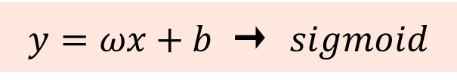
Linear Regression
Logistic Regression
$$y=ωx+b$$
$y=ωx+b$ → $sigmoid$
Support Vector Machine for Regression
Support Vector Machine
for Classification
$$y=ωx+b$$
$y=ωx+b$ → $sign\left(∙\right)$
Artificial Neural Networks for Regression
Artificial Neural Networks for Classification
$$y=ωv+b$$
$y=ωv+b$ → $softmax\left(∙\right)$

Slide 3
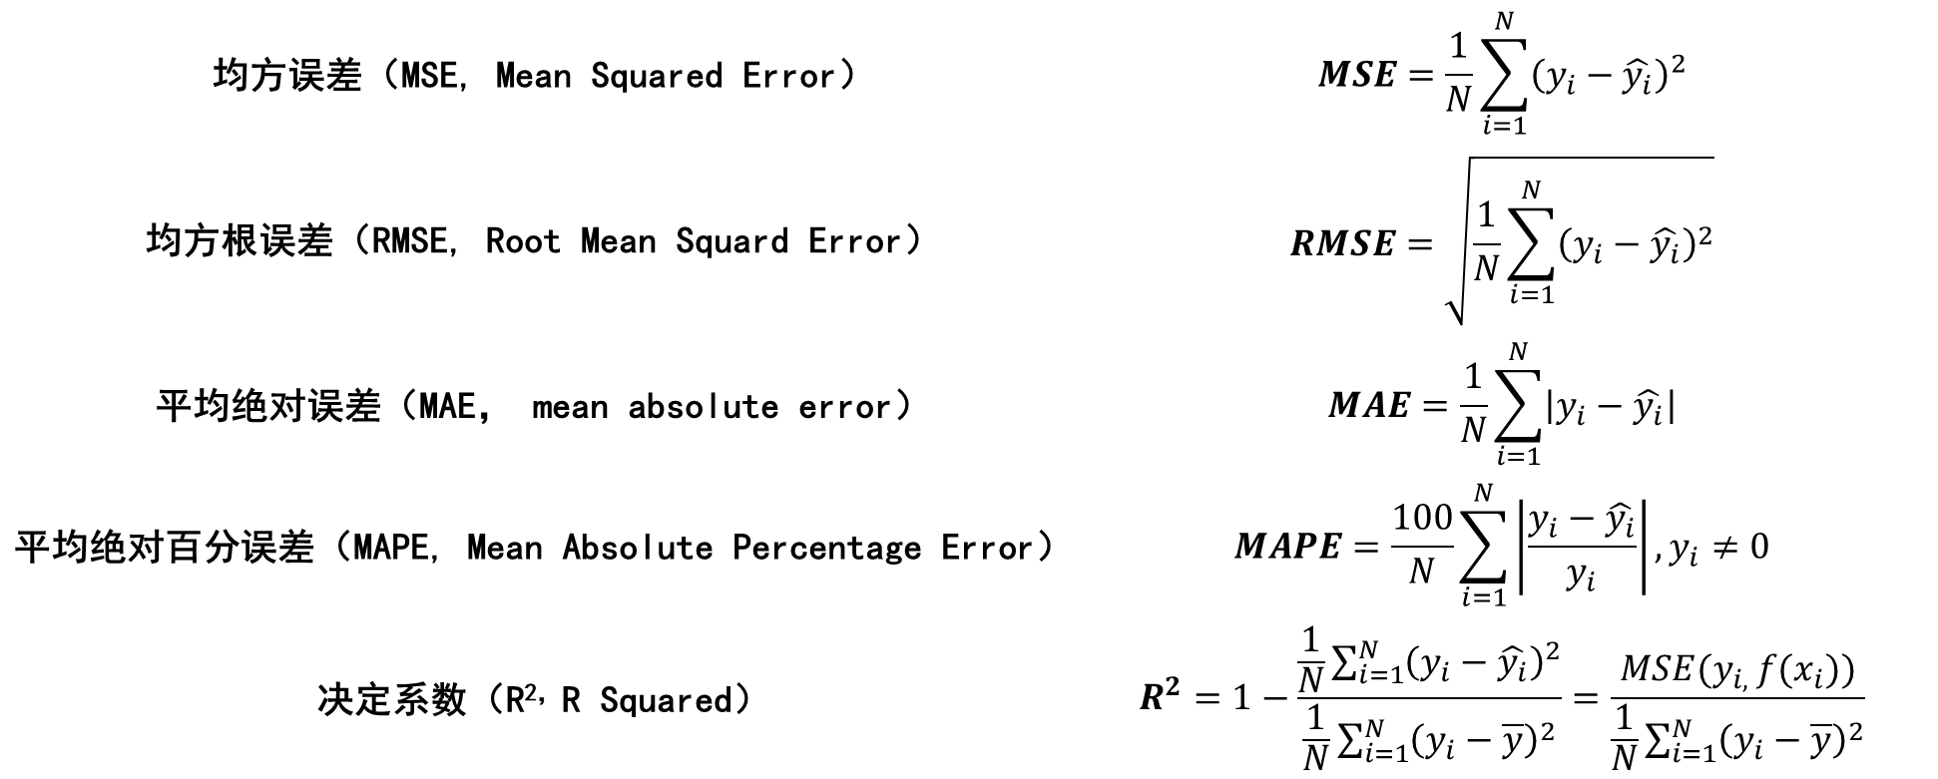
均方误差（MSE, Mean Squared Error） | $$MSE=\frac{1}{N}\sum_{i=1}^{N}{{\left(y_{i}−\hat{y_{i}}\right)}^{2}}$$
均方根误差（RMSE, Root Mean Squard Error） | $$RMSE=\sqrt{\frac{1}{N}\sum_{i=1}^{N}{{\left(y_{i}−\hat{y_{i}}\right)}^{2}}}$$
平均绝对误差（MAE， mean absolute error） | $$MAE=\frac{1}{N}\sum_{i=1}^{N}{\left|y_{i}−\hat{y_{i}}\right|}$$
平均绝对百分误差（MAPE, Mean Absolute Percentage Error） | $$MAPE=\frac{100}{N}\sum_{i=1}^{N}{\left|\frac{y_{i}−\hat{y_{i}}}{y_{i}}\right|}, y_{i}≠0$$
决定系数（R^{2，}R Squared） | $$R^{2}=1−\frac{\frac{1}{N}\sum_{i=1}^{N}{{\left(y_{i}−\hat{y_{i}}\right)}^{2}}}{\frac{1}{N}\sum_{i=1}^{N}{{\left(y_{i}−\overline{y}\right)}^{2}}}=\frac{MSE(y_{i, }f(x_{i}))}{\frac{1}{N}\sum_{i=1}^{N}{{\left(y_{i}−\overline{y}\right)}^{2}}}$$

Slide 4
Model | Parameters Differences
Support Vector Machine | epsilon
Random Forest | criterion
K-Nearest Neighbors | None
XGBoost | None

Slide 5
Thank yo u
f or watching

